Slide 1

MOOC (Massive Open Online Learning):
the New Way of Learning
Seminar Edukasi
Fintech: What and How to Embrace It
Presented by: Lucy M. Pandjaitan
CEO IndonesiaX

Slide 2
WHY MOOC FOR INDONESIA
Challenges
Quantity and quality of human capital
Skills/competency and aptitude
Need for economic growth
Need to create job opportunities (entrepreneurs)
Need to be globally competitive (competition from neighboring countries)
Teacher training (school, TVET and higher education)
Access to education and training in general (spread out in 17,000 islands and 34 provinces)
Opportunities
Rapid changes in ITE
Indonesia is one of the countries with highest internet users (69 million cellular phone users in 2016, compared to 27 million in 2013)
Preparing for demographic bonus in 2025 to 2035 (number of people within the productive age bracket is higher than the number of elderly people and children)

Slide 3

www.indonesiax.co.id

Slide 4

INDONESIAX.CO.ID
Web-based platform which offers:
free high quality, massive open online courses (MOOCs) from
best local and foreign universities, government agencies, companies and other institutions
In order to:
democratize education
improve life-skills of Indonesians spread out in Indonesian archipelago
thus enriching lives

Slide 5
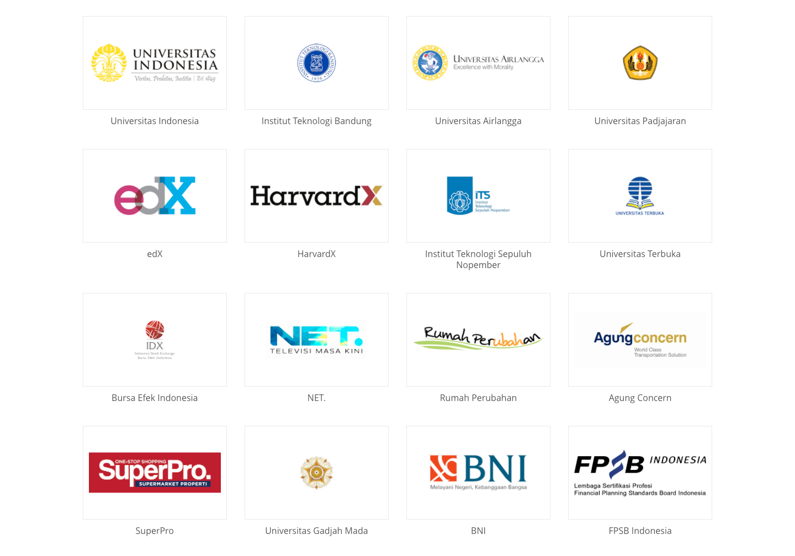
OUR PARTNERS

Slide 6

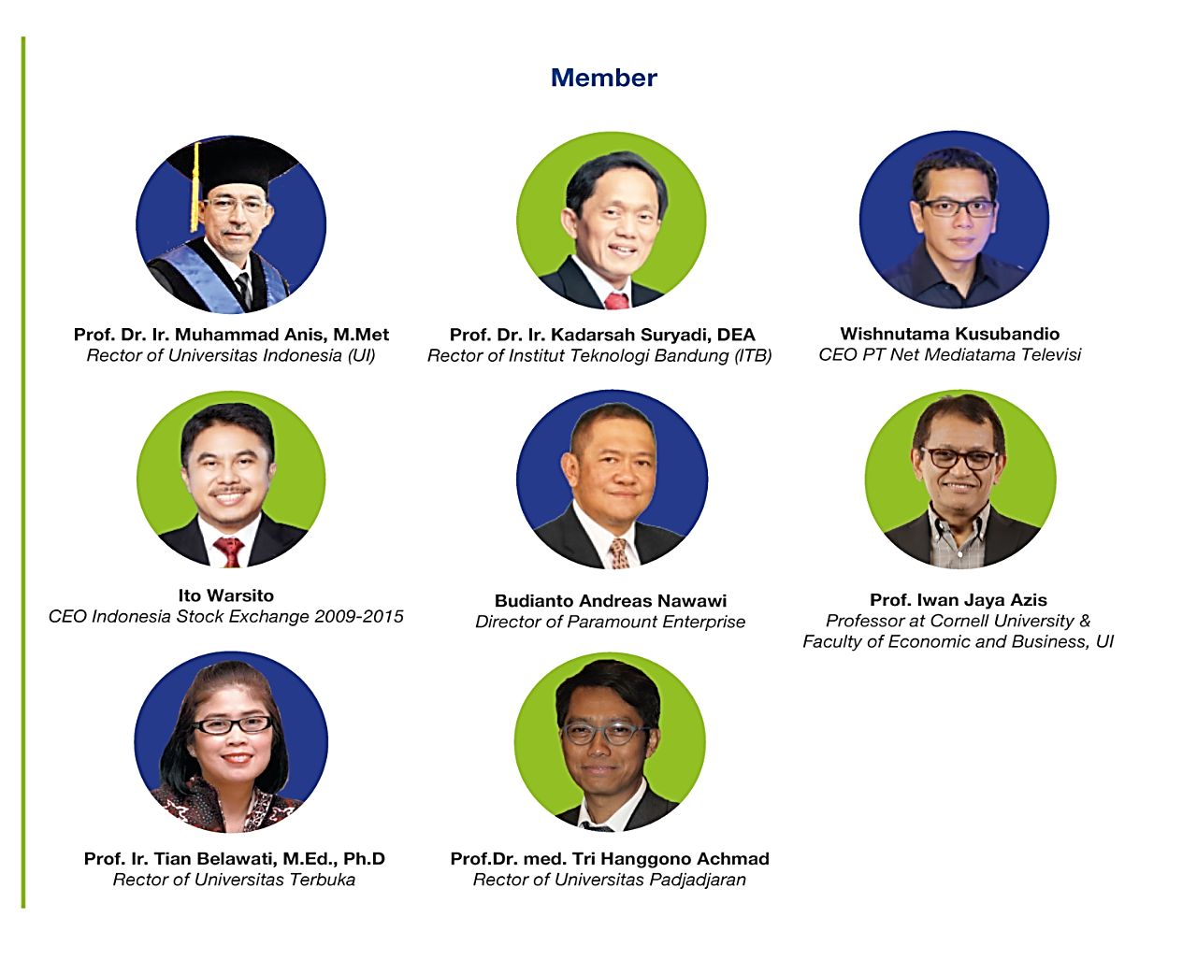
OUR ADVISORY COUNCIL

Slide 7
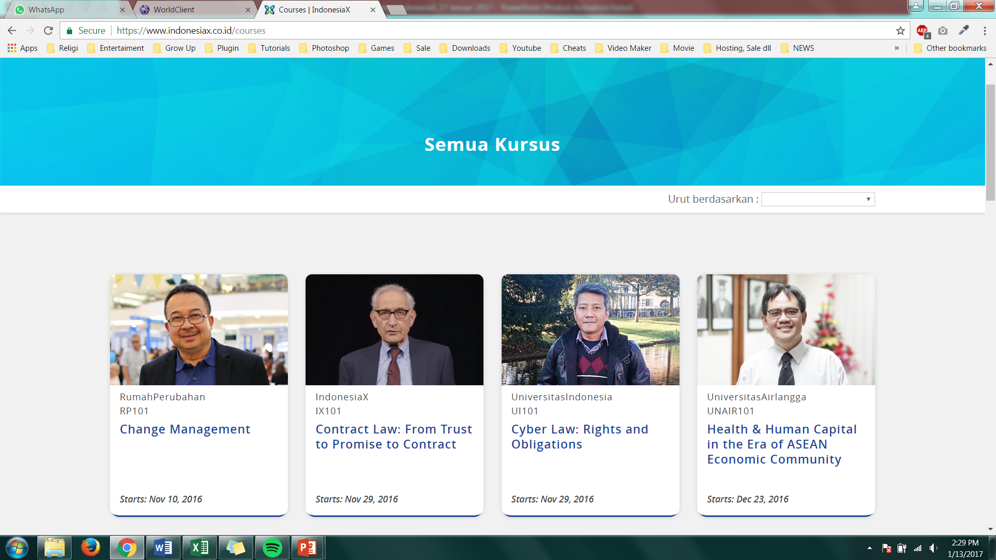
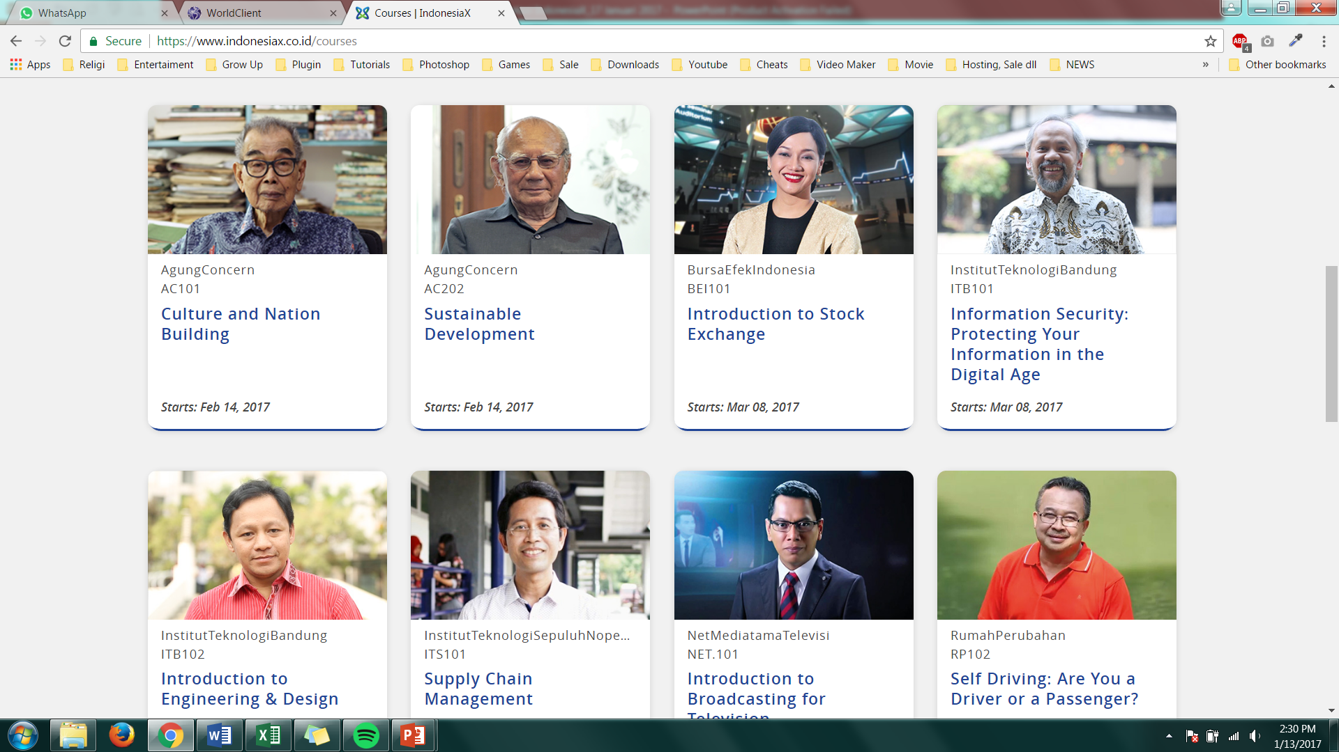
OUR COURSES
We aim for 30% Academic and 70% Life Skills
First Launch: Aug 17, 2015
First Launch: May 2, 2016
First Launch: Aug 17, 2015
First Launch: Aug 17, 2016
First Launch: Feb 14, 2017
First Launch: Feb 14, 2017
First Launch: Aug 17, 2015
First Launch: Feb 14, 2016

Slide 8
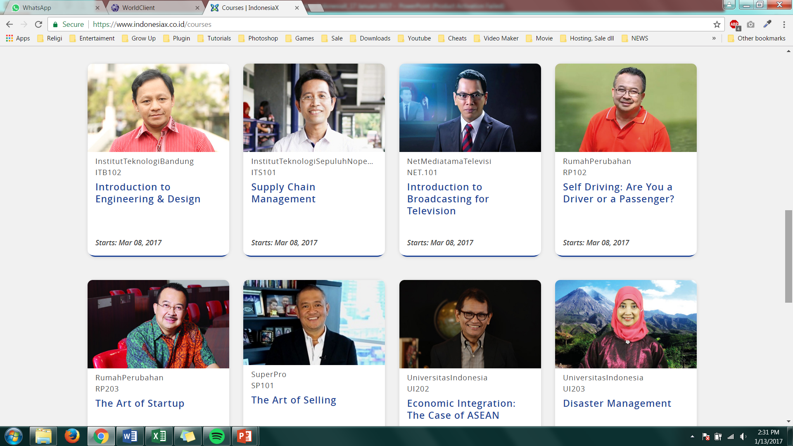
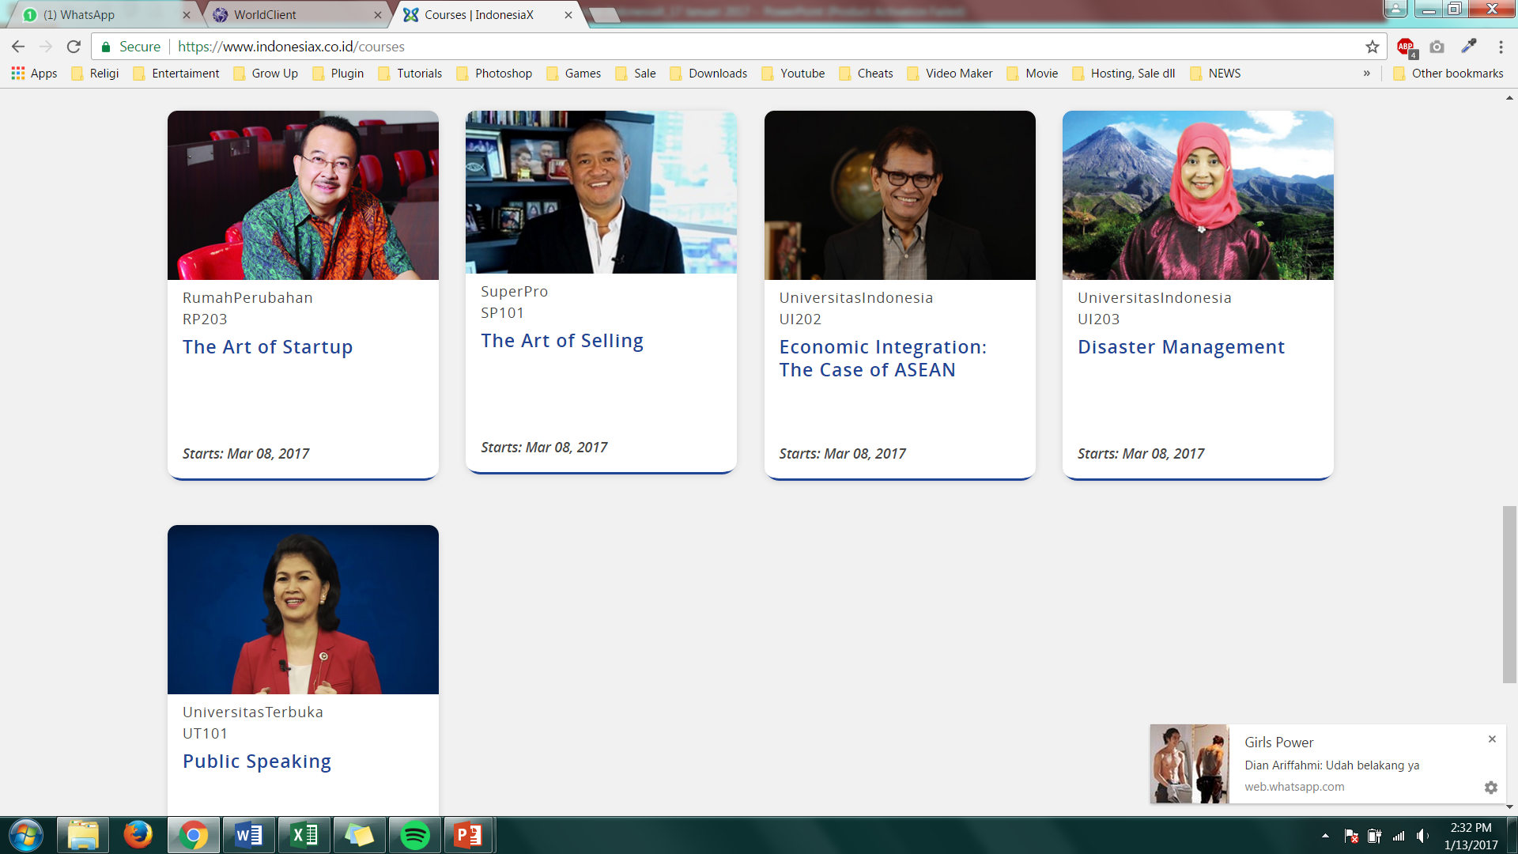
OUR COURSES
We aim for 30% Academic and 70% Life Skills
First Launch: Mar 14, 2016
First Launch: May 2, 2016
First Launch: Dec 1, 2015
First Launch: Dec 22, 2015
First Launch: Aug 17, 2016
First Launch: Nov 10, 2016
First Launch: Feb 14, 2016
First Launch: Nov 10, 2016

Slide 9
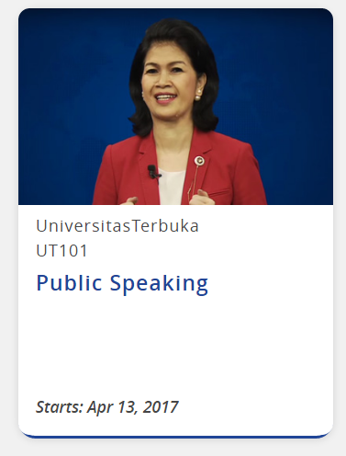
OUR COURSES
We aim for 30% Academic and 70% Life Skills
Upcoming Courses to be Launched:
UI 204 - Economic Development
UI 205 - Micro-Finance
UNPAD 101 - Children’s Allergy
BNI 101 - Introduction to Banking
BNI 102 - Financial Literacy
FPSB 101 - Code of Ethics
FPSB 101 - Sharia
First Launch: Feb 14, 2016

Slide 10
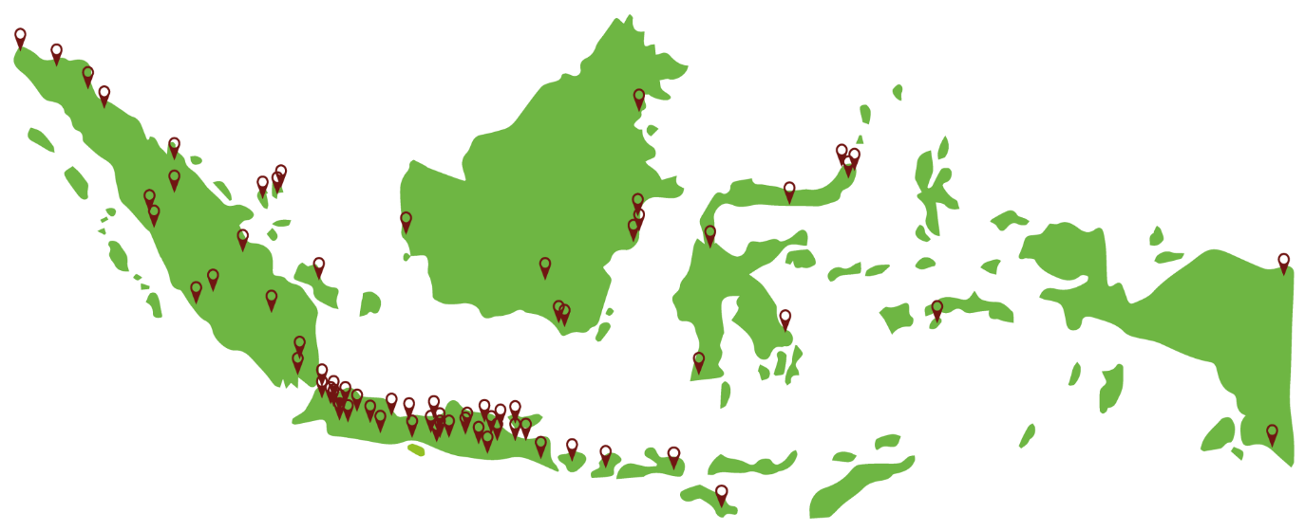
WHERE WE ARE NOW - INDONESIA
as per Dec 31, 2016
Top 5 Provinces
1. West Java 23,3%
2. DKI Jakarta 16,9%
3. East Java 13,9%
4. Banten 7,6%
5. Central Java 7,1%
Learners from Java 68,8%
Learners from other 31,2%
provinces in Indonesia

Slide 11
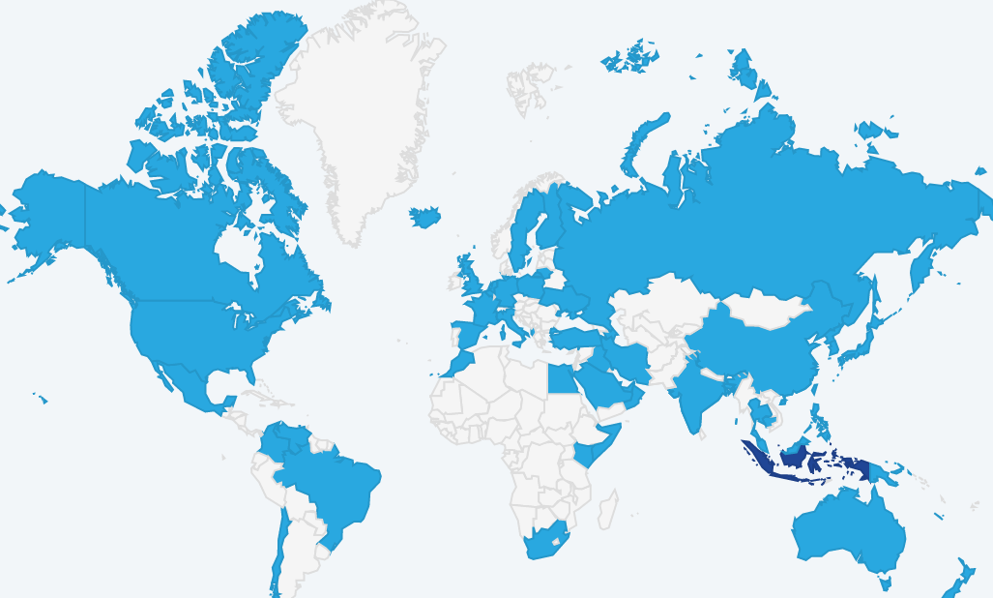
GLOBAL REACH
as per Dec 31, 2016
# Countries
135
# Course Registrants
87.938
# Cities
943
# of Page Views
5.153.881

Slide 12
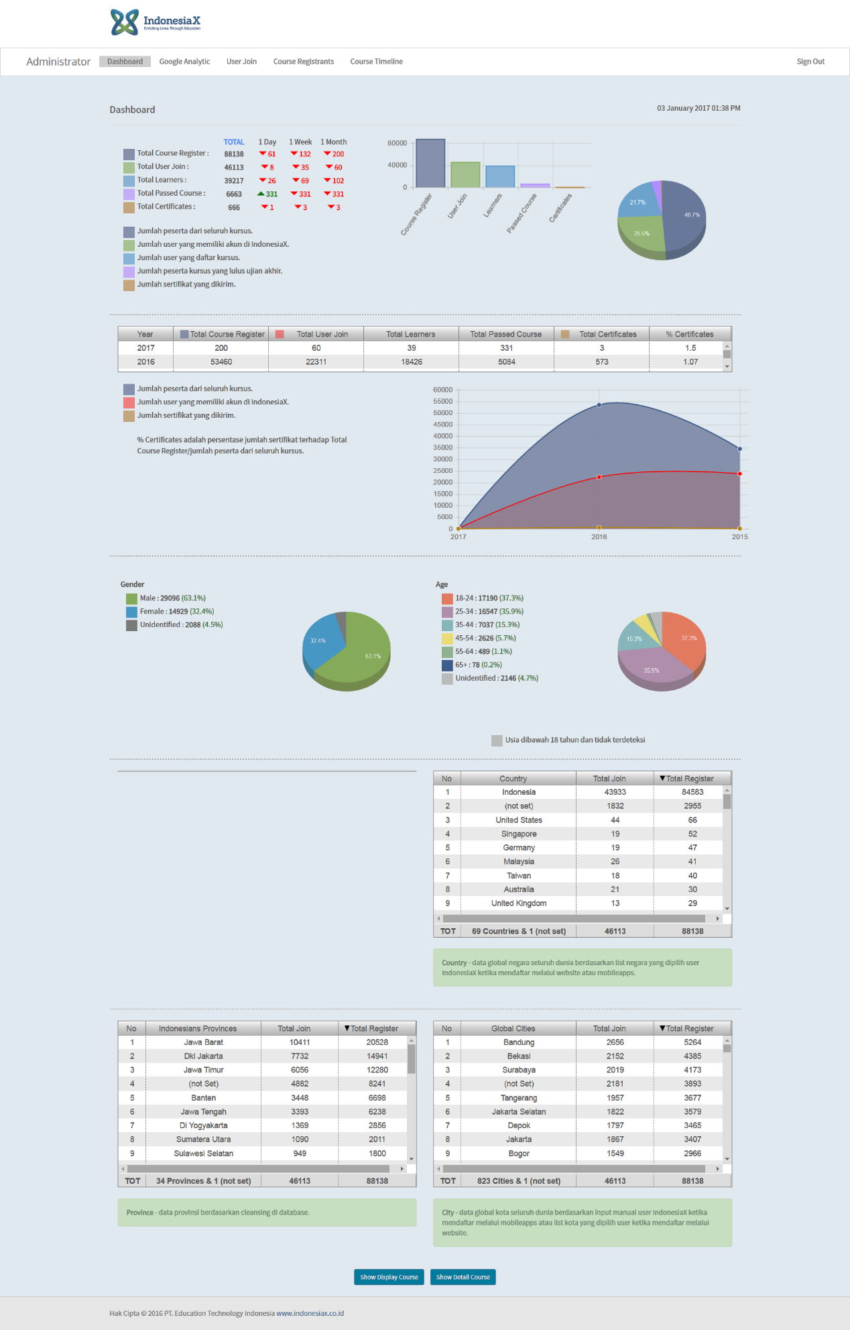
OUR LEARNERS
as per Dec 31, 2016
Ratio (certificates to learners) | 2015 | 2016
 | 0.29% | 1.04%
Most learners are from 18-24 and 25-34 age bracket
More male learners than female ones
Ratio of certificates vs learners is on increasing trend

Slide 13
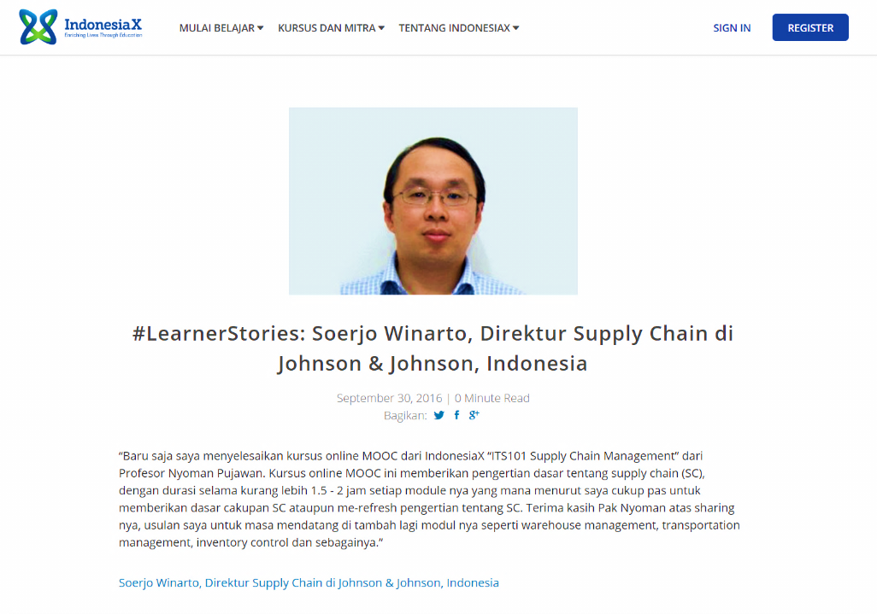
LEARNERS’ STORIES

Slide 14
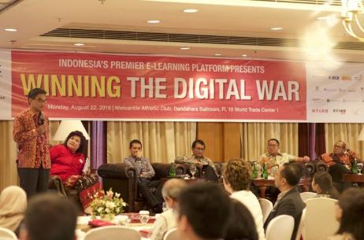
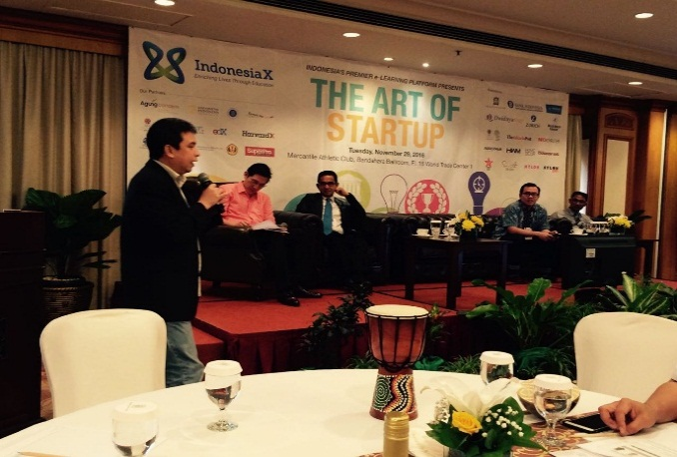
OUR SEMINAR SERIES
Jakarta, 22-08-16
Jakarta, 29-11-16

Slide 15
THANK YOU
Please check us out
at www.indonesiax.co.id

